Slide 1
Chapter 3
Stacks
Objectives
Upon completion you will be able to
Explain the design, use, and operation of a stack
Implement a stack using a linked list structure
Understand the operation of the stack ADT

Slide 2
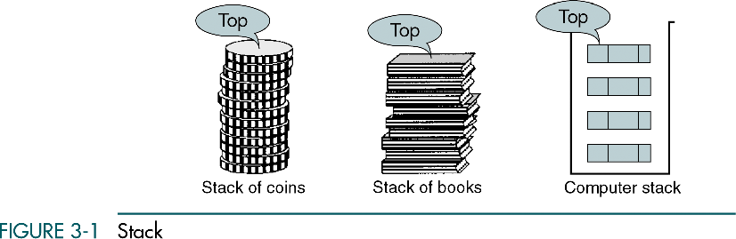

Slide 3
3.1 Basic Stack Operations
The stack concept is introduced and three basic stack operations are discussed.
3.2 Stack Linked List Implementation
In this section we present a linked-list design for a stack. After developing the data structures, we write pseudocode algorithms for the stack ADT.
3.3 C Language Implementations
This section presents a simple non-ADT implementation of a stack. We develop a simple program that inserts random characters into the stack and then prints them.
3.4 Stack ADT
We begin the discussion of the stack ADT with a discussion of the stack structure and its application interface. We then develop the required functions.
3.5 Stack Applications
Three basic application problems-parsing, postponement, and backtracking-are discussed and sample programs developed. In addition, several other stack applications are presented, including the classic Eight Queens problem.
3.6 How Recursion Works
This section discusses the concept of the stack frame and the use of stacks in writing recursive software
3-1 Basic Stack Operations
The stack concept is introduced, and three basic stack operations are discussed.
Push
Pop
Stack Top

Slide 4
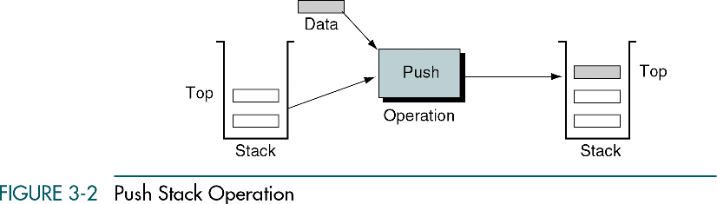

Slide 5
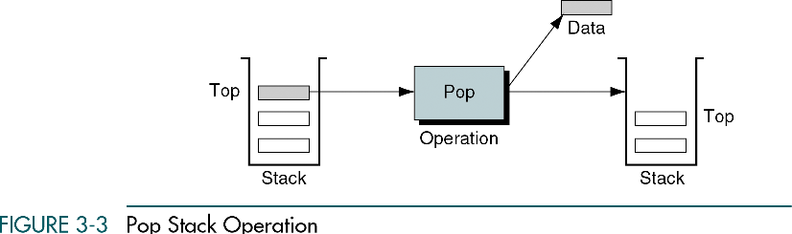

Slide 6
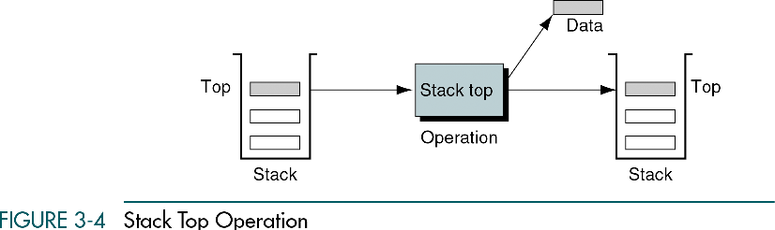

Slide 7
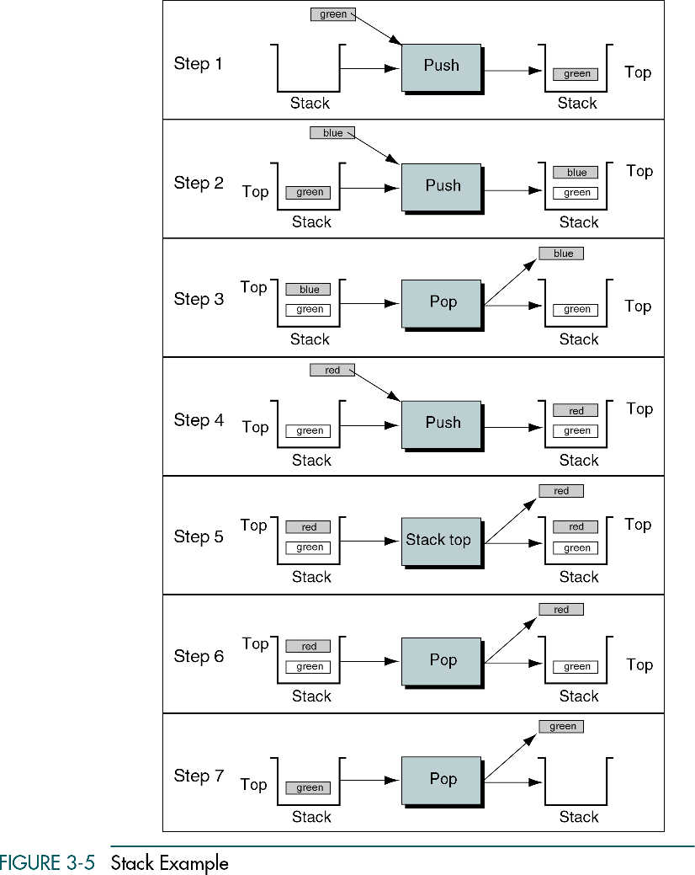

Slide 14
Stack can be implemented as an array

Slide 15
Stack as an array
public arrayStack(int size) {
data = new Object[size];
top = -1;
}
[0]
[1]
[2]
[3]
[4]
null
null
null
null
null
top = index of the first element in the array

Slide 16
Add an element to the stack: arrayStack.add(“A”)
public void add(E element) {
top++;
data[top] = element;
}
[0]
[1]
[2]
[3]
[4]
A
null
null
null
null
top = 0

Slide 17
Add three more elements to the stack: arrayStack.push(“B”), arrayStack.add(“C”), arrayStack.add(“D”)
public void push(E element) {
top++;
data[top] = element;
}
[0]
[1]
[2]
[3]
[4]
A
B
C
D
null
top = 3

Slide 18
Now remove an element
Top=3
[0]
[1]
[2]
[3]
[4]
Before
A
B
C
D
null

Slide 19
Now remove an element
Top=3
[0]
[1]
[2]
[3]
[4]
Before
A
B
C
D
null
[0]
[1]
[2]
[3]
[4]
Remove
A
B
C
null

Slide 20
We need to update the top variable
Top=3
[0]
[1]
[2]
[3]
[4]
Before
A
B
C
D
null
[0]
[1]
[2]
[3]
[4]
Remove
A
B
C
null
Top=2

Slide 21
We need to update the top variable
Top=3
[0]
[1]
[2]
[3]
[4]
Before
A
B
C
D
null
[0]
[1]
[2]
[3]
[4]
Remove
A
B
C
null
Top=2
[0]
[1]
[2]
[3]
[4]
Remove
A
B
null
Top=1

Slide 22
We need to update the top variable
Top=3
[0]
[1]
[2]
[3]
[4]
Before
A
B
C
D
null
[0]
[1]
[2]
[3]
[4]
Remove
A
B
C
null
Top=2
[0]
[1]
[2]
[3]
[4]
Remove
A
B
null
Top=1
Top=0
[0]
[1]
[2]
[3]
[4]
Final
A
null

Slide 23
What happens if we continue removing elements from the stack?
Top=0
[0]
[1]
[2]
[3]
[4]
Before
A
null

Slide 24
What happens if we continue removing elements from the stack?
Top=0
[0]
[1]
[2]
[3]
[4]
Before
A
null
Top=-1
[0]
[1]
[2]
[3]
[4]
After
null

Slide 25
What happens if we continue removing elements from the stack?
Top=0
[0]
[1]
[2]
[3]
[4]
Before
A
null
Top=-1
[0]
[1]
[2]
[3]
[4]
After
null
We cannot remove any more elements when top==-1

Slide 26
What happens when the stack is full?
Top=?
[0]
[1]
[2]
[3]
[4]
A
B
C
D
E

Slide 27
3-2 Stack Linked List Implementation
In this section we present a linked-list design for a stack. After developing the data structures, we write pseudocode algorithms for the stack ADT.
Data Structure
Algorithms

Slide 28
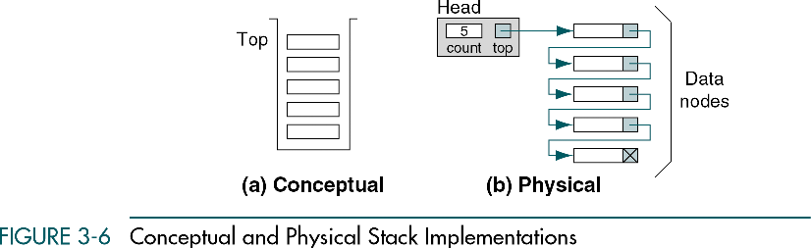

Slide 29
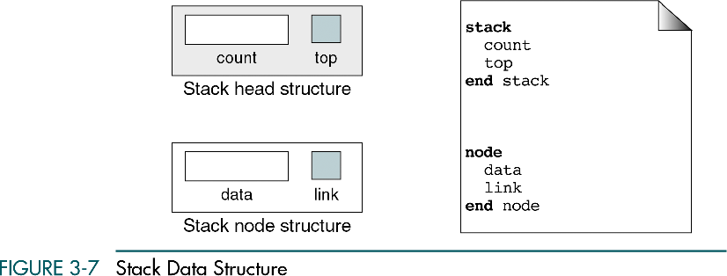

Slide 30
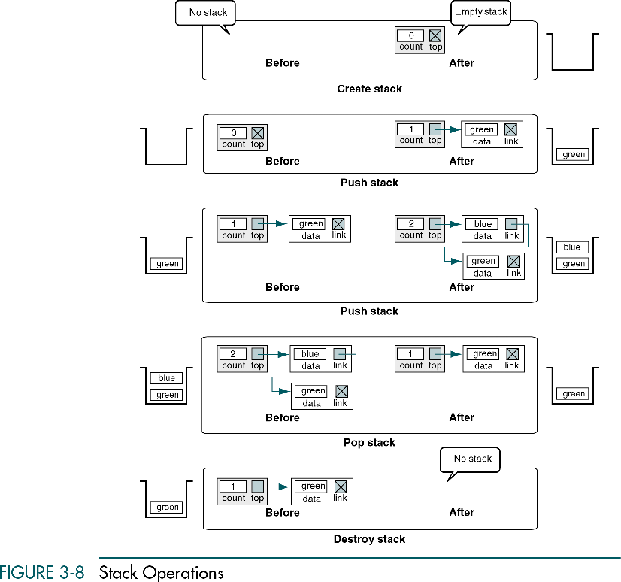

Slide 31
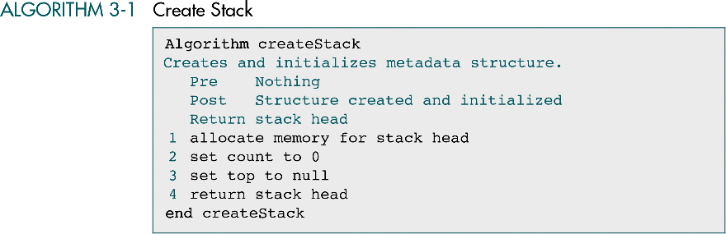

Slide 33
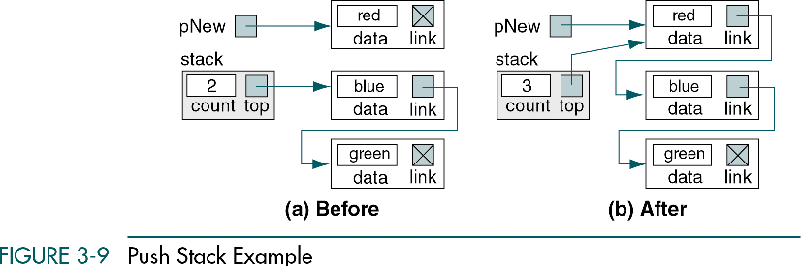

Slide 34
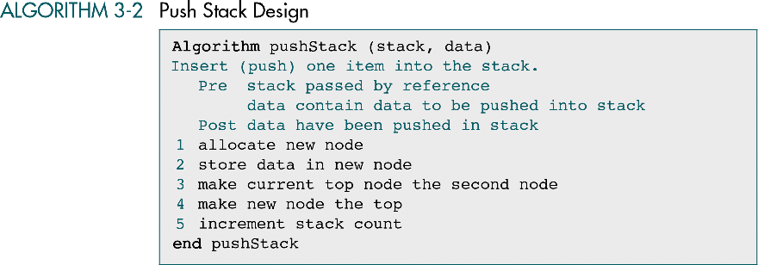

Slide 36
Pop Operation

Slide 37
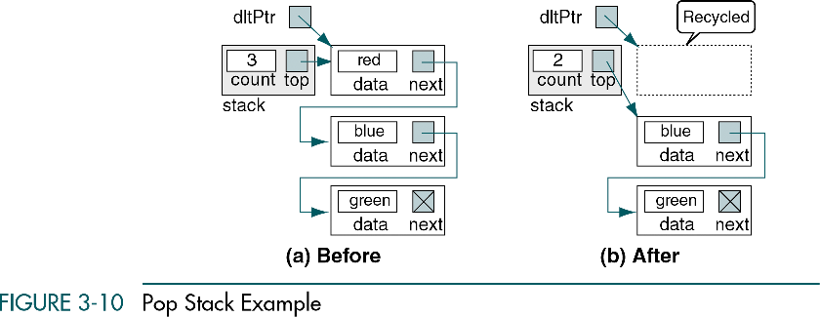

Slide 38
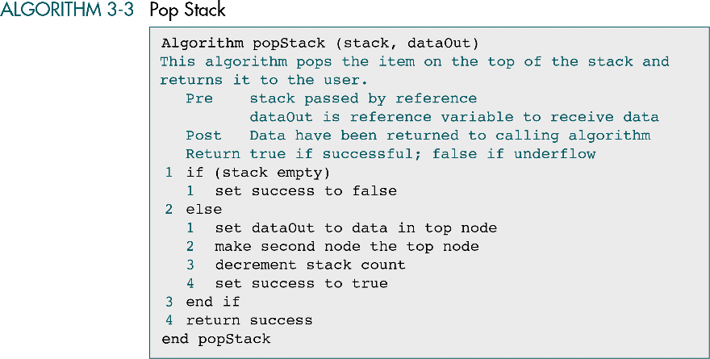

Slide 39
What happens if we call stackTop function?

Slide 40
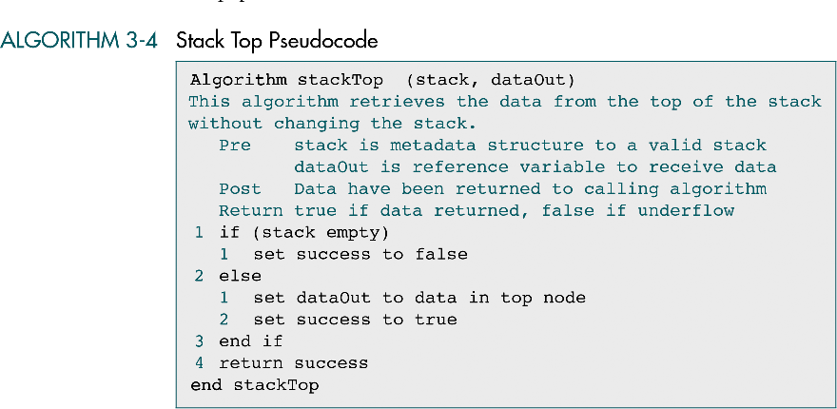

Slide 41
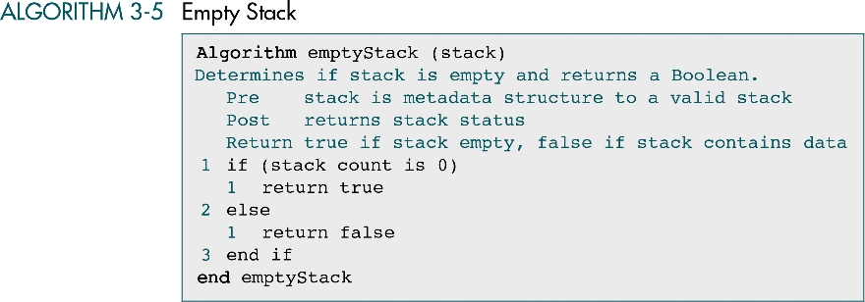

Slide 42
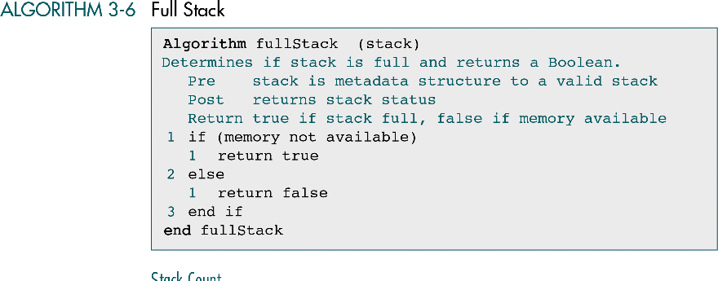

Slide 43
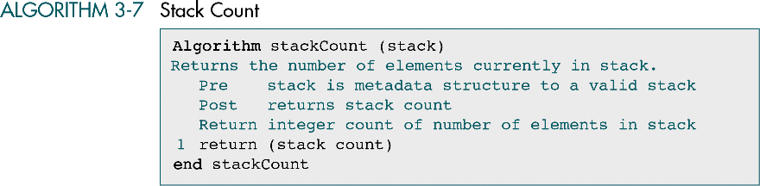

Slide 44
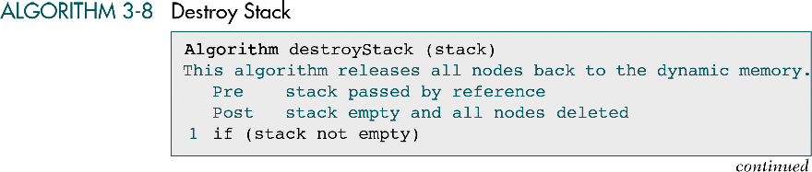

Slide 45
What happens if we destroy the stack?

Slide 47
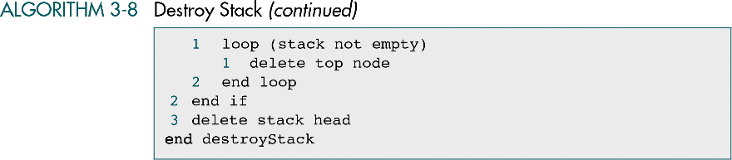

Slide 48
3-3 C Language Implementations
This section presents a simple non-ADT implementation of a stack. We develop a simple program that inserts random characters into the stack and then prints them.

Slide 49
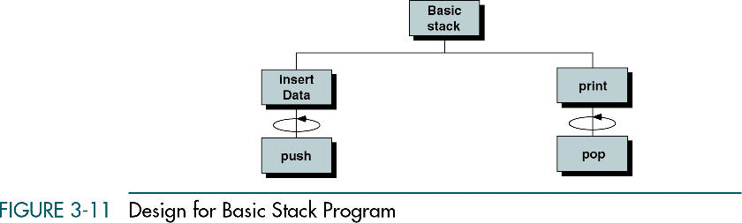

Slide 50
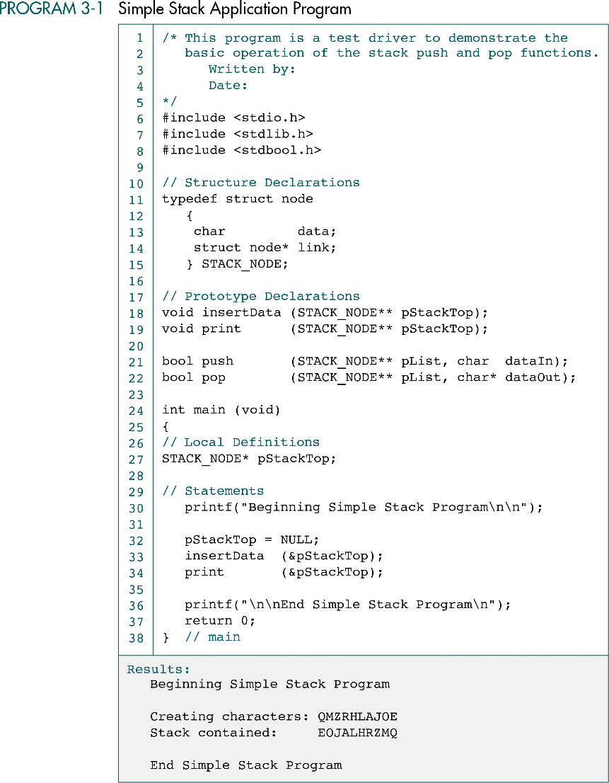

Slide 51
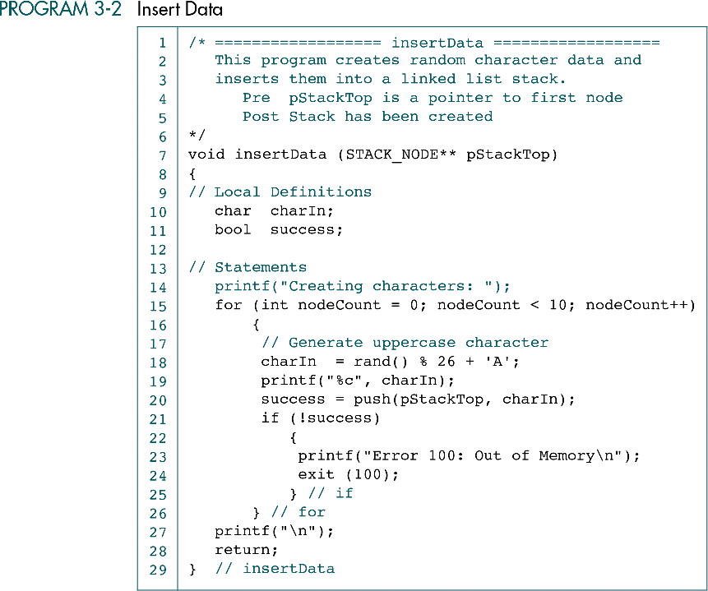

Slide 52
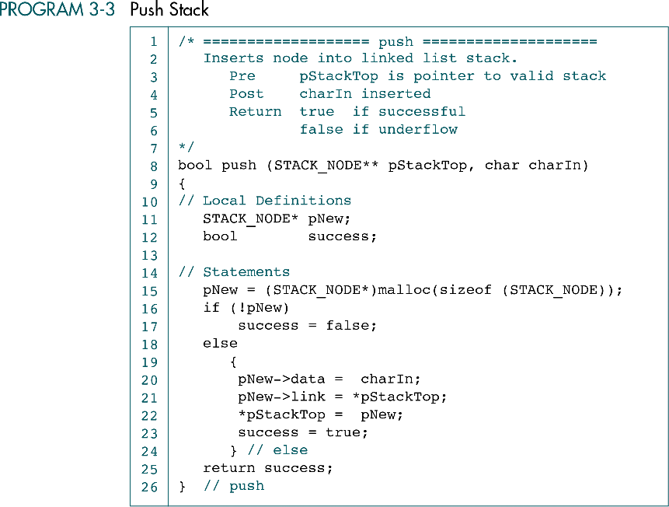

Slide 53
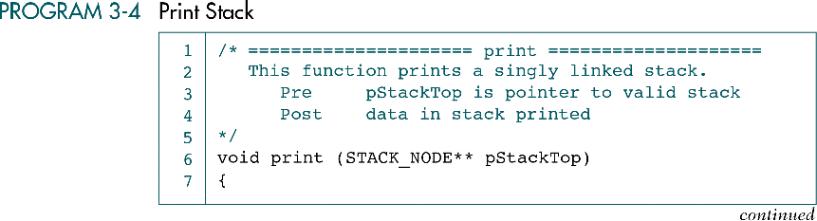
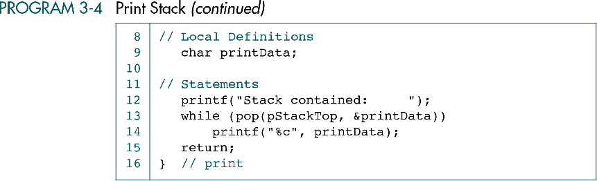

Slide 54
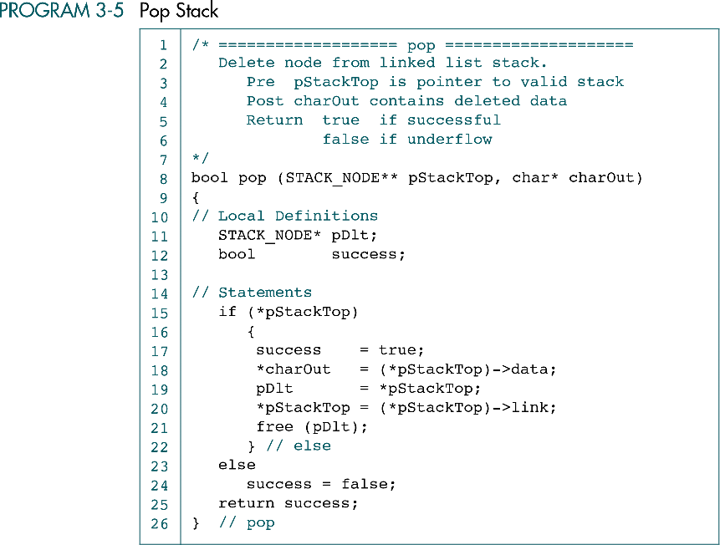

Slide 55
3-4 Stack ADT
We begin the discussion of the stack ADT with a discussion of the stack structure and its application interface. We then develop the required functions.
Data Structure
ADT Implemenation

Slide 56
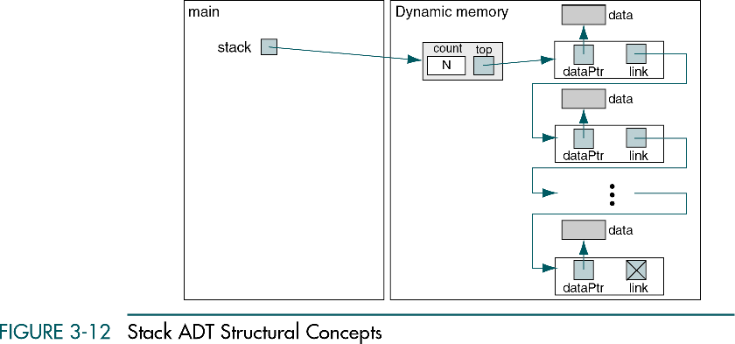

Slide 57
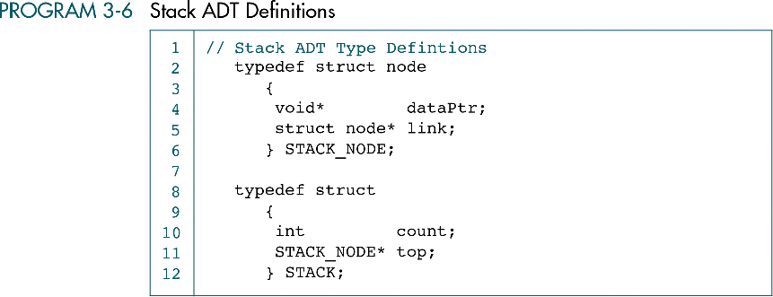

Slide 58
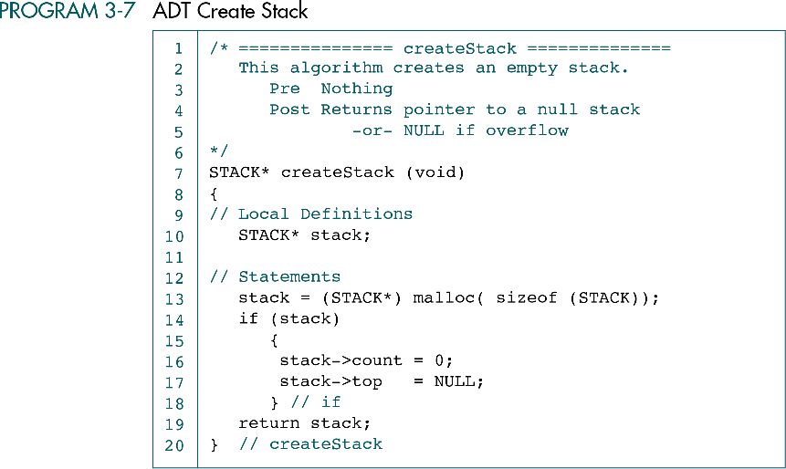

Slide 59
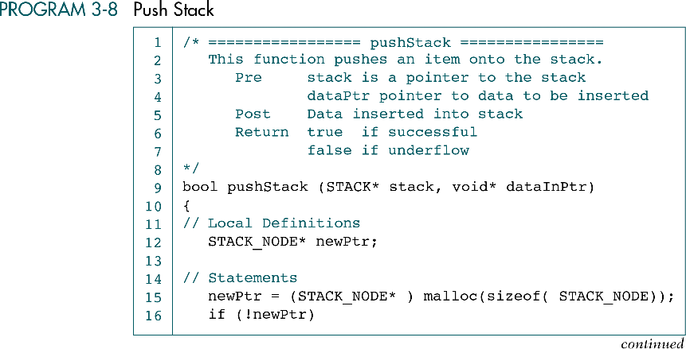
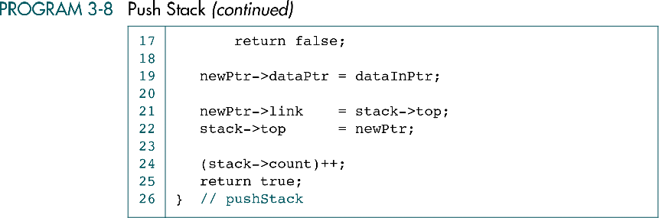

Slide 60
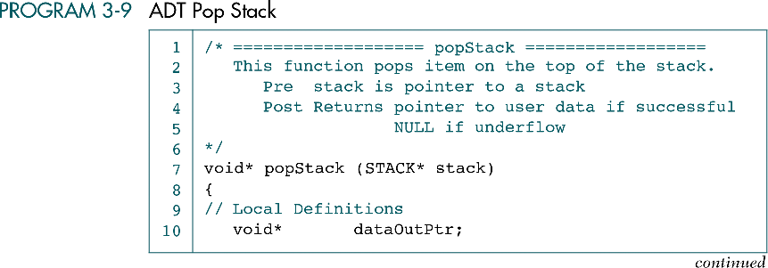

Slide 61
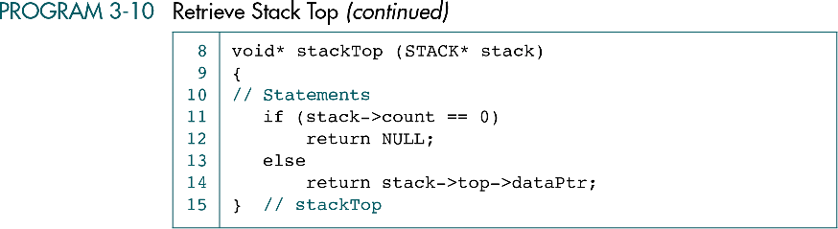

Slide 62
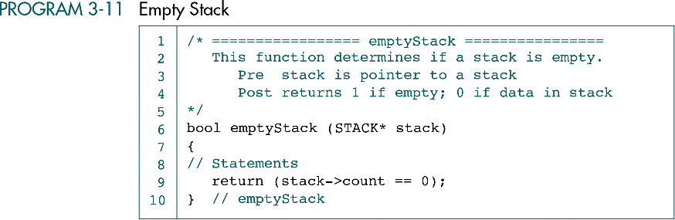

Slide 63
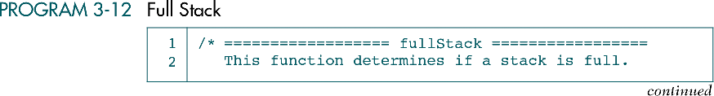
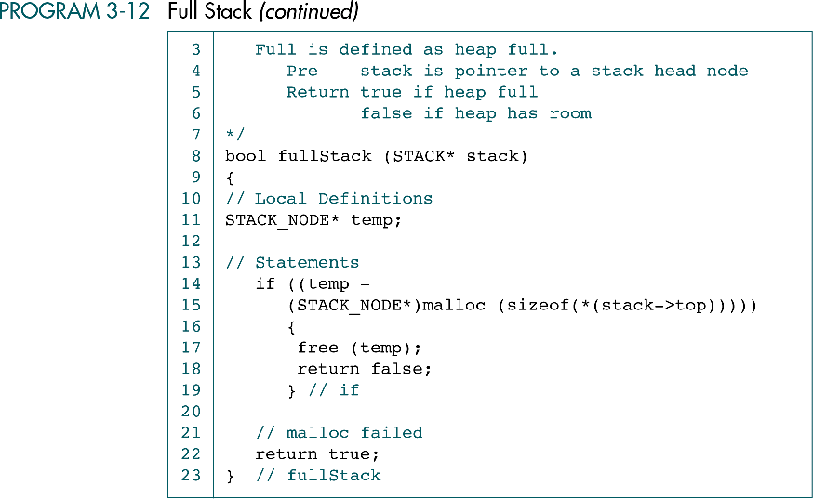

Slide 64
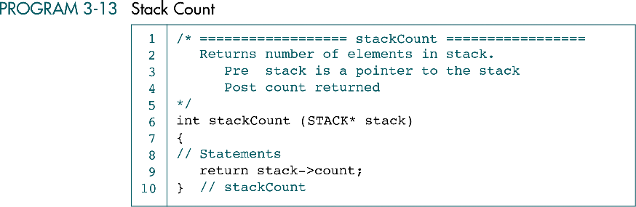

Slide 65
